Slide 1

RISHIKAR SATYALA
SHIVANANDA REDDY
TEAM JANUS
PROJECT SOLARIS

Slide 2


Since I was a kid, I have always looked up at the sky rather than down the ground. You know, there’s something about space that truly inspires me, it makes me feel greater than life, greater than this existing human form.
Since then, I've developed an interest in sci-fi movies that question our existence, and one such film is Solaris (1972).
A small group of cosmonauts are the focus of Solaris, a tale about their quest to explore beyond earth and search for other humans in the cosmos. During this process, they visit Solaris, an other planet.
A phenomenon on Solaris connects these astronauts to people apparitions from their own pasts. These new people provide new perspectives to the cosmonauts and help them discover themselves.
So, The cosmonauts are looking for connections rather than new worlds because neither their existence nor all existence is independent. It is determined by our interactions and connections. It is impossible to determine one's selfhood in isolation.
THE ORIGIN

Slide 3
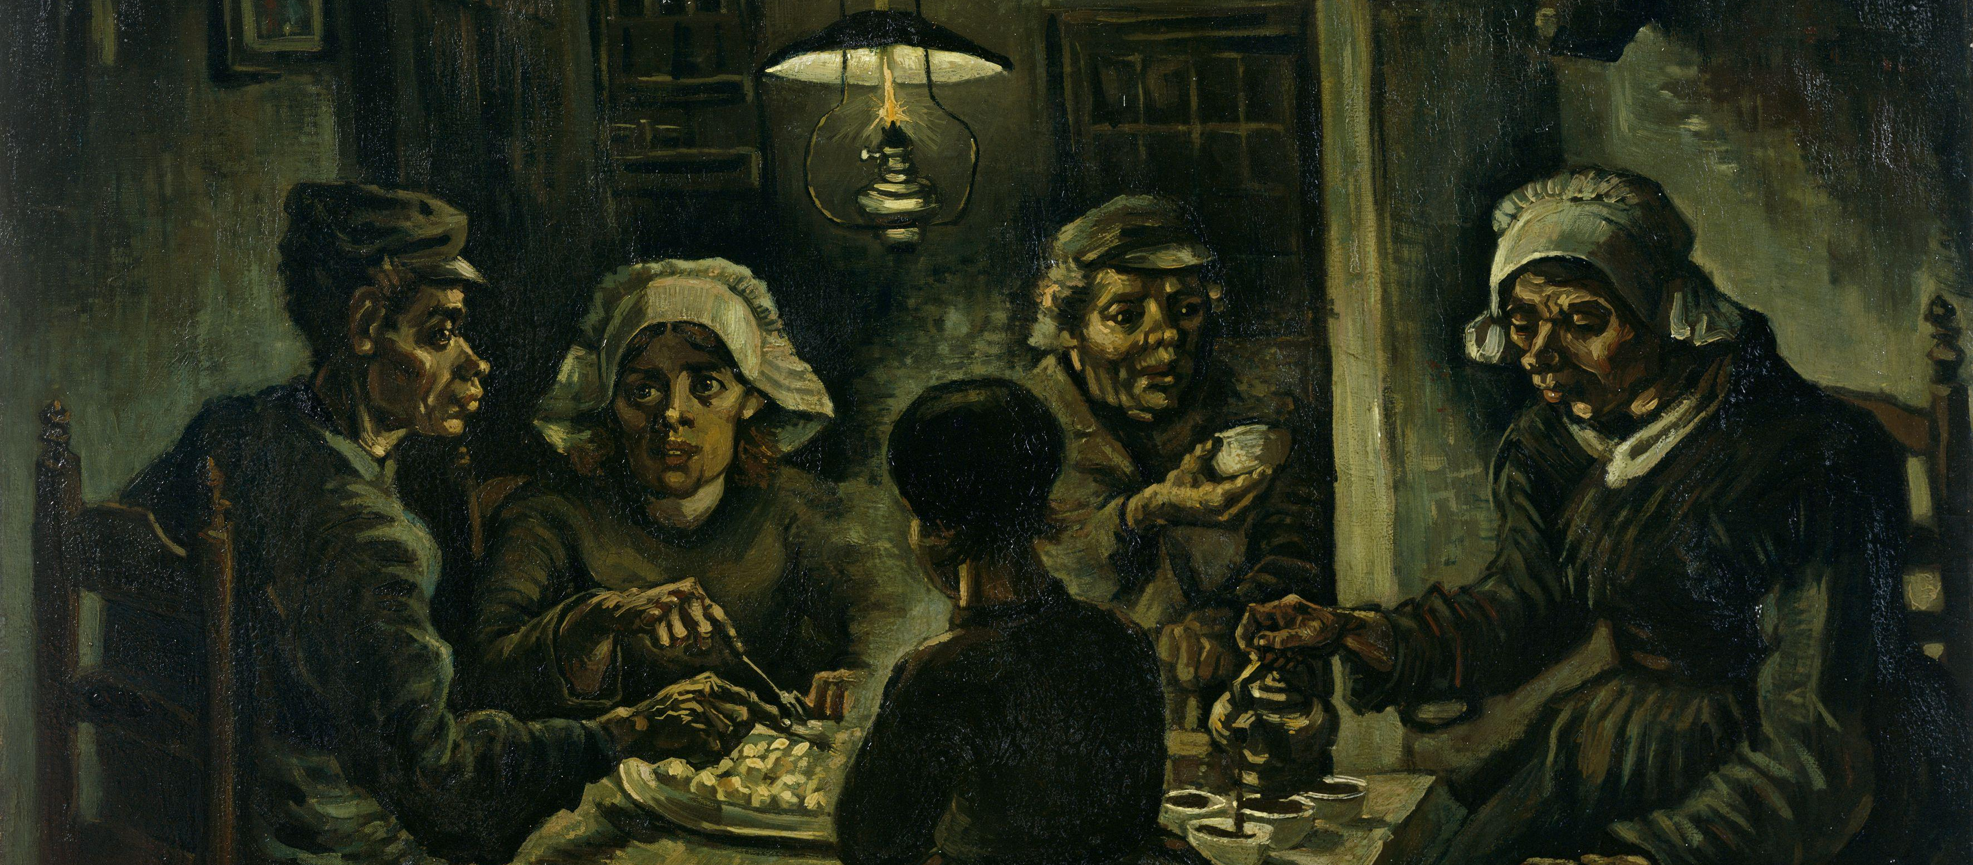
THE IDEA
So just like how the cosmonauts were looking for new connections to share something, we also have many stories left untold, problems left unshared. Because we don’t really have good spaces to share your stories and problems without being criticised.
A space where people empathize with you and provide different perspectives and solutions for your stories and problems that you would never think of.
So we created a space to truly share where you will be able to share your stories and problems in the form of fictional stories and let other people experience it and give their perspective and solutions for your problems just as the people in Solaris.

Slide 4

THE PSYCHOLOGY BEHIND THE IDEA
So just like how the cosmonauts were looking for new connections to share something, we also have many stories left untold, problems left unshared. Because we don’t really have good spaces to share your stories and problems without being criticised.
A space where people empathize with you and provide different perspectives and solutions for your stories and problems that you would never think of.
So we created a space to truly share where you will be able to share your stories and problems in the form of fictional stories and let other people experience it and give their perspective and solutions for your problems just as the people in Solaris.

Slide 5

IMPLEMENTATION
We put this idea into action by creating a website/app where people can enter their stories or problems as a fictional story or a direct situation. They must tell their story through arguments and choices. They can provide their own options or directly accept the input of others. People will be able to experience other people's stories, problems, and so on by playing the protagonist and making decisions as if they were in their shoes. And can express their thoughts on it

Slide 6

TARGET AUDIENCE
The target audience for this project is people aged 18-29 who are most prone to anxiety and depression in their lives due to various problems and are unable to share it with anyone due to fear of criticism from others and a lack of an appropriate platform for it, and these people are the most active on social media platforms. This is the primary target audience. However, the use cases of Solaris do not stop there; it has a very broad scope of implementation, such as a quick narrative storyboard for a game!

Slide 7
BUSINESS MODEL
We will be including ads in the UI itself. They will be part of the ui and wont be popping up or be distraction to the sole content. We integrate ads just like other social media platforms and we’ll generate revenue from it. Also we can promote specific stories from companies or individuals by monetising the process. But the user can easily filter them out using built inn features, so that it wont be distracting

Slide 8
QUESTIONS RAISED
How is this different from subreddits on reddit and other self care apps?
Subreddits are forums dedicated to a specific topic on reddit and 72% of reddit users report that they use reddit for entertainment purposes and 43% to get news. So subreddit Is not at all a self help thing as most of the people use it for entertainment and news and this dominates the whole use case of reddit.
Also on reddit forums you can only just share as a post, but on Solaris it’s an experience which lets others be in your shoes and share their perspectives.
How is it different from self help apps?
Most of the self help apps just generalise the problems and put out common solutions. Its not at all personalised to you. But in Solaris you will be able to connect with people and make interactions only based on your interest.
What if the connection turn out to be negative?
We certainly can’t control people and their interactions, all we can do is provide them a better tool. So we give total control to the user who’s posting the stories. Its totally in their hand to accept responses or they could just give their own options and let others choose between them. Only if the user likes the perspective given by a person only then they can start interaction. So its totally in the hands of the user to decide who to interact with.

Slide 9

THANK YOU

